Slide 1
Lesson Overview
Begin with the Stop & Think on HO3 (new) -3min. Have a brief discussion (no more than 5 min, just get 2-3 ideas out on the table)
Set goals for the day 2min– We will develop a consensus model for the class that provides the entire explanation of why the fish died. First we will have two groups present their models and then we will develop one together
Two groups present- 15min- Have the focus groups present (about 7 min for each group including a bit of discussion).
Build class model 20 min- together we will make a class model that represents the ideas we all agree about in terms of why the fish died
Post test 17-20 (no more than 20 unless they get extra time)- read instructions (slide) and let them work.
(no Before You Go today)
Total time- 65 mins.

Slide 2
LESSON 4 - DAY 4

Slide 3
STOP & THINK!
Complete the second STOP & THINK! question on the page.
Why are models important when we are trying to figure out why things are happening in the world?
Notes:
Use this “Stop & Think” as a do now. 3min
Have a very brief class discussion, just get 2-3 ideas out.
.

Slide 4






What have we figured out about why the fish died?
Today we are going to develop a class consensus model: a model we all agree about
First we will look at a few examples of your models
Then we will make a class model
Dead Fish
Notes:
15min– Have the two focus groups present in turn
We will project MEME from our machines, and log in as the focus group so they can present their models
Have students discuss the presenting groups model– don’t let this get too long, we do need time to make the consensus model and some of these disagreements can get hashed out then

Slide 5
Class model: Why did the fish die in Passion Puddle?
Dead Fish
Notes:
We will make the model here. (next slide has example- FOR YOUR EYES ONLY)
The “ideal” model should have the following sequence: (however, there are acceptable variations to this so be open)
Rain causes dirt with fertilizer (nutrients) to wash into the pond.
Nutrients in fertilizer make the algae bloom (sunlight also contributes to the bloom)
Algae eventually die (they also use air and some students see them as contributing to the low dissolved air problem, which is true)
Decomposers break down dead matter to get energy (mostly algae) and use up the dissolved air
Low dissolved air causes fish to suffocate

Slide 6
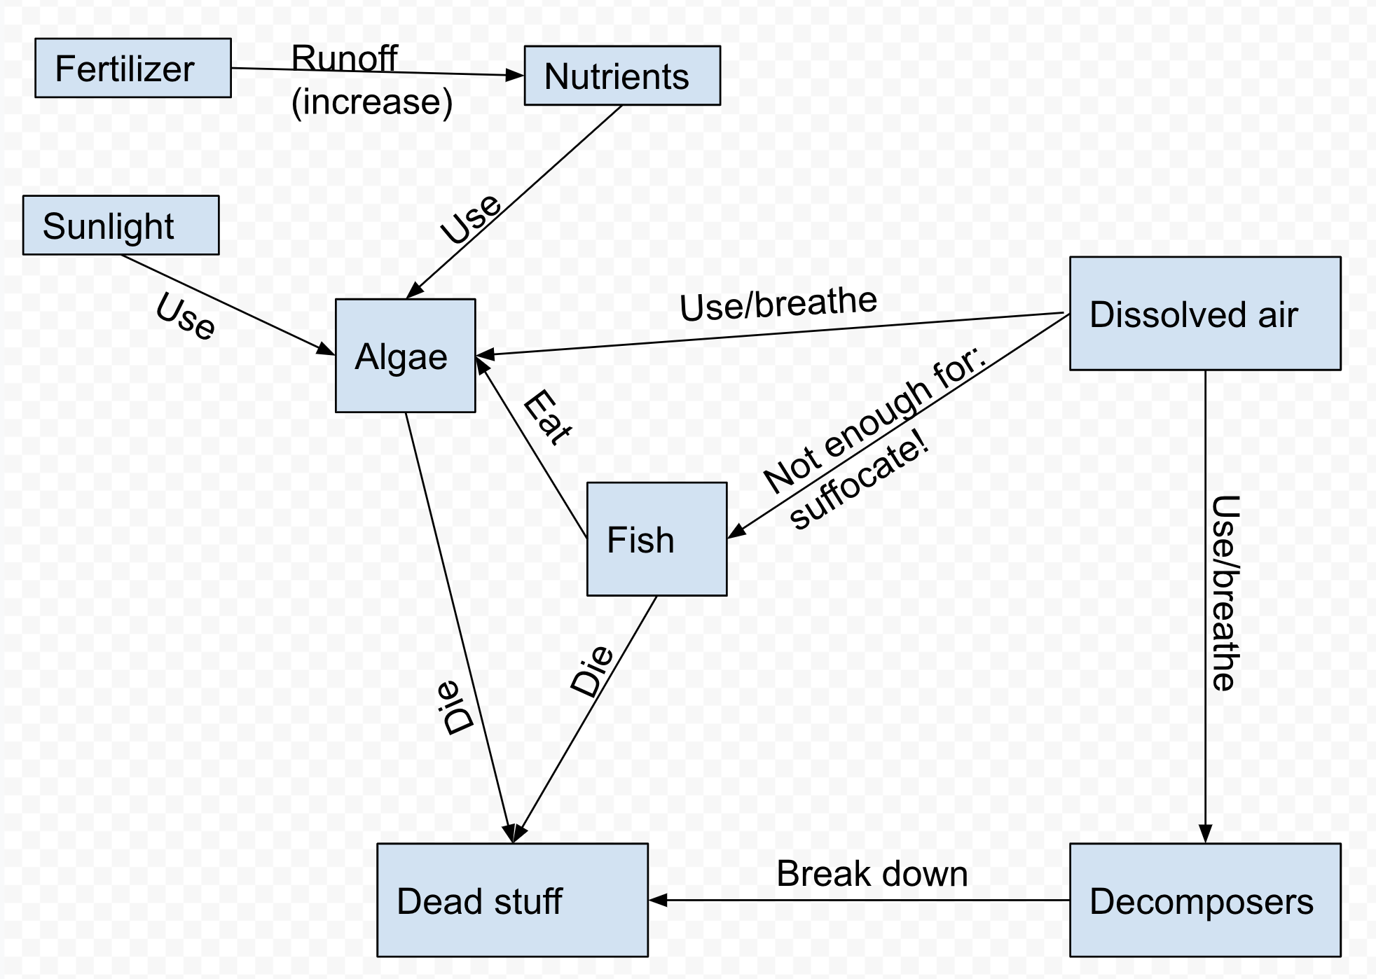
Class model: Why did the fish die in Passion Puddle?
Dead Fish
Notes:
We will make the model here.
The “ideal” model should have the following sequence: (however, there are acceptable variations to this so be open)
Rain causes dirt with fertilizer (nutrients) to wash into the pond.
Nutrients in fertilizer make the algae bloom (sunlight also contributes to the bloom)
Algae eventually die (they also use air and some students see them as contributing to the low dissolved air problem, which is true)
Decomposers break down dead matter to get energy (mostly algae) and use up the dissolved air
Low dissolved air causes fish to suffocate

Slide 7

Post Test
Please read the questions carefully
Answer in as much detail as you can
Use what we learned in class!
Notes:
Please handout post test, read instructions. Do what we did for the pre-test.
Give them 17 min (unless they get extra time)

Slide 8
End of Class
Notes:
There is no Before You Go today

Slide 9
Evidence Set
Lesson 4
Why are there more algae?
Notes:
In case you need to project evidence, they are all here

Slide 10
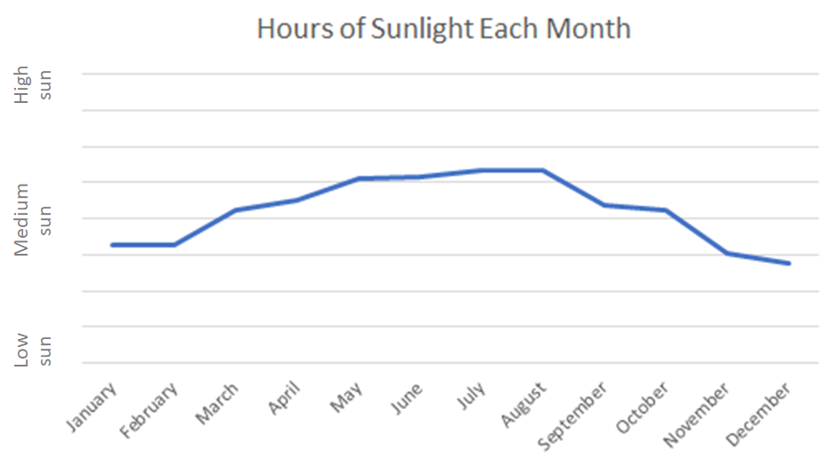
Amount of Sunlight at Passion Puddle
Around Passion Puddle there are instruments that can measure the amount of sunlight hitting the water. Here are the measurements of sunlight from each month during the year in which there was an algal bloom (too much algae):

Slide 11
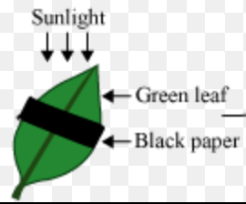
Plants in Sunlight
Plants are producers. This means they produce their own food (sugar) using sunlight energy. Scientists did an experiment to see what happens if only part of a leaf gets sunlight. They took a plant and selected five big green leaves. They then covered half of each leaf with a piece of aluminum foil, to hide that half from the sun, like the diagram below.
After a couple of days, they picked the leaves off the plant and tested each section of the leaf to see if it made sugar. They found sugar only in the parts of the leaves that were left out in the sun. There was no sugar in the parts that were covered.

Slide 12

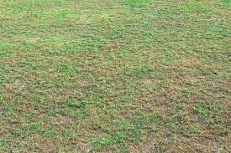
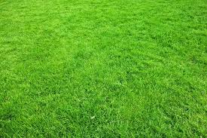
Fertilizer and Plants
Part A: Fertilizer for Water Lilies
The football field at Penn State is not used much during the spring. This is when the Penn State gardeners add fertilizer to the field. One of the gardeners took a photo to show what the grass looks like at the end of football season (January) and what it looks like in the spring after it has been fertilized in March.
Field in January Before Fertilizer Field in Spring After Fertilizer

Slide 13
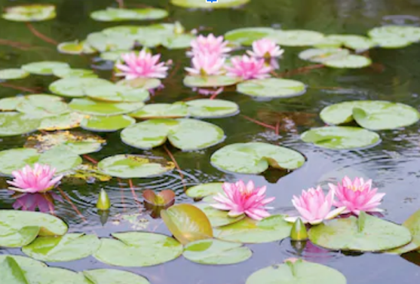
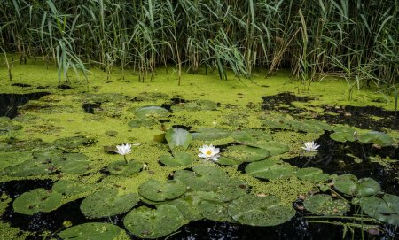
Penn State also has a wonderful lotus pond with water lilies. The gardeners wondered if the same amount of fertilizer would work for increasing the beautiful water lilies. They added the fertilizer and the water lilies grew a lot, but the algae in the pond grew, too. Instead of becoming more beautiful, the pond became green and mucky!
Before Fertilizer After Fertilizer

Slide 14
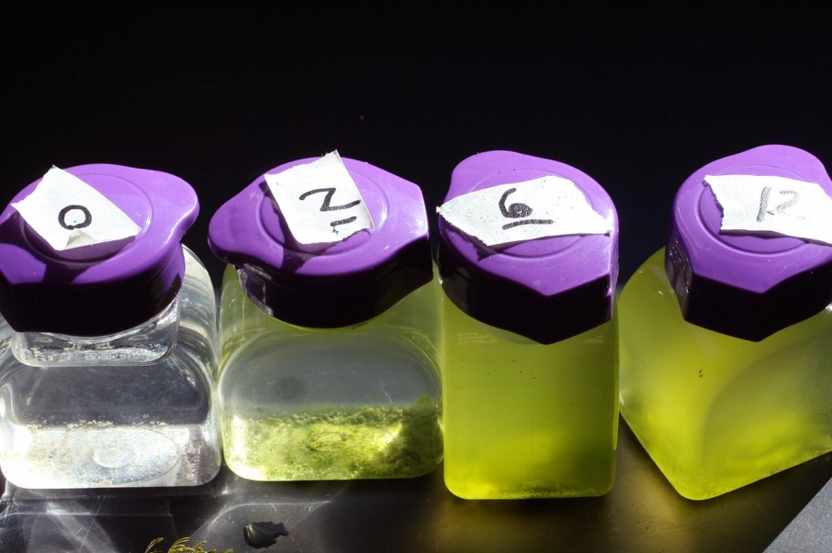
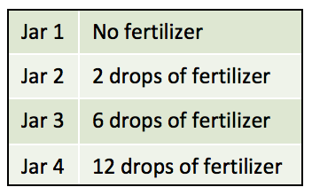
Part B: Fertilizer and Algae
The gardeners decided to test how much fertilizer made the algae grow so that they could put in just enough to help the water lilies, but not so much that the pond gets full of algae.
They took four jars of pond water. They did not add any fertilizer to the first jar. In the second jar they added 2 drops of fertilizer. In the third jar they added 6 drops of fertilizer. In the fourth jar they added 12 drops of fertilizer.
They observed the jars after one month to see what happened to the algae. Here are their results:

Slide 15
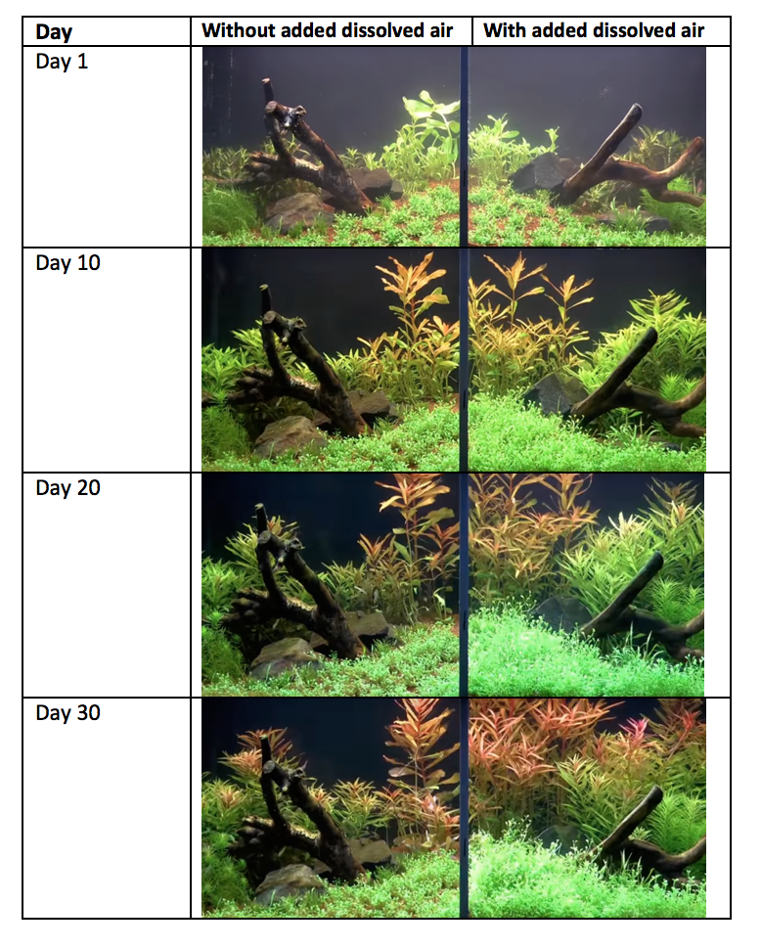
Air in Aquariums
In the Adventure Aquarium in New Jersey, aquarists (aquarium experts) wanted to try a new machine that adds dissolved air into the water, to see if they should buy it for more tanks.
To find out, they put two tanks side by side. They planted the same plants in each of them. Then, in one tank, they connected the machine so that it would add dissolved air into the water so that it had lots of dissolved air. In the other tank they did not do anything: whatever dissolved air was already in the water stayed, but they did not add any new air.
They took photos of the tank every 10 days for a month. They also posted the pictures on their website so that members of the public could see the experiment. The photos are shown here:

Slide 16
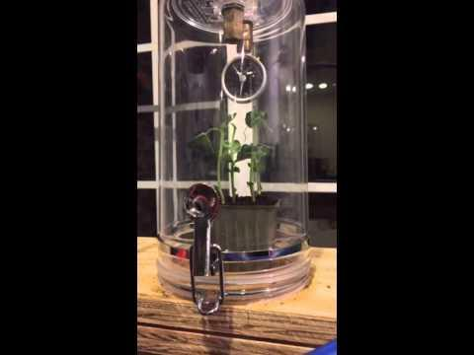
The aquarists also wanted to show visitors what happens when plants are put in a vacuum machine. They put a plant in a vacuum machine and turned it on. The machine sucks the air out of the jar. They filmed it for six hours and sped it up into this video that they posted on the website:
Notes:
(Video here: https://www.youtube.com/watch?v=H3oyYEp7eTo)

Slide 17
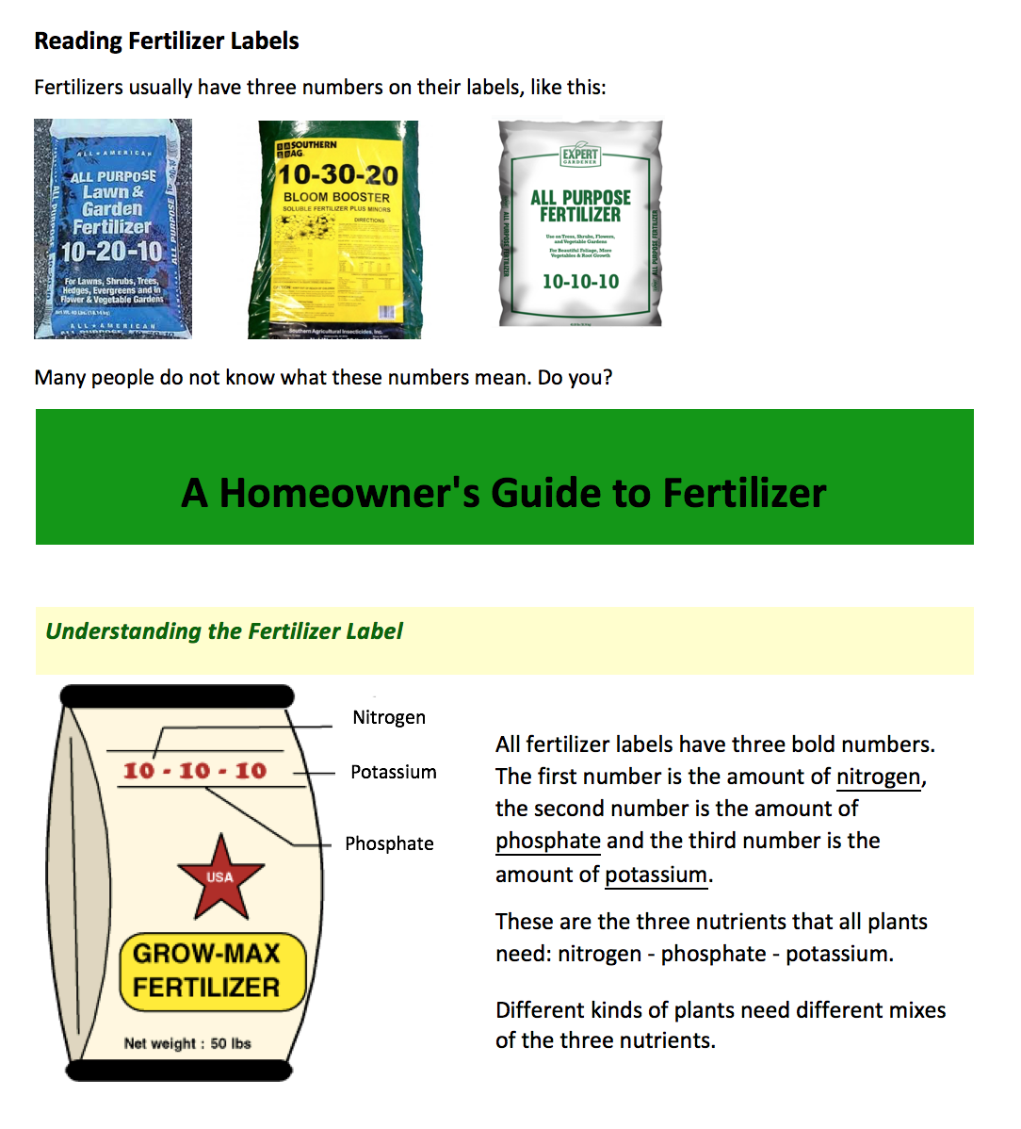

Slide 18
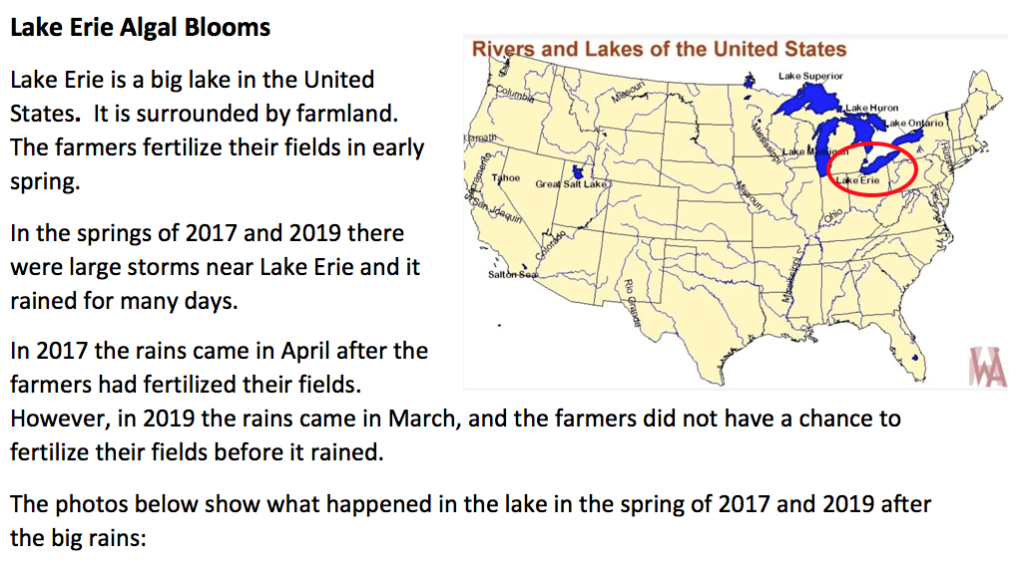

Slide 19
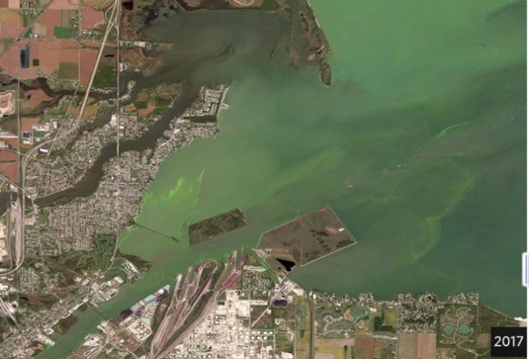
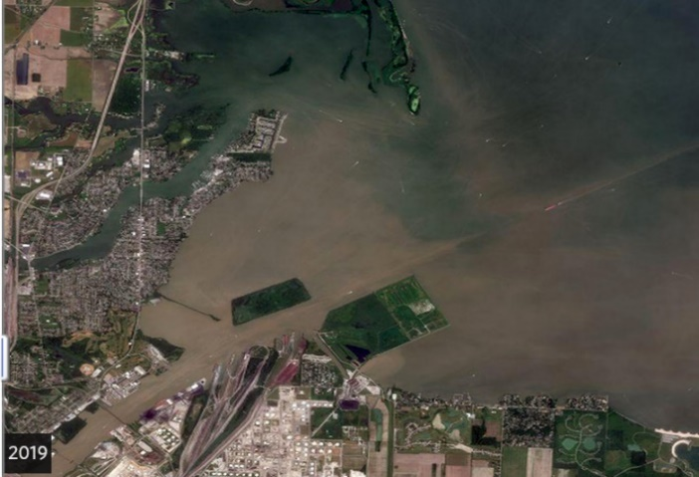
2017
2019
Rain washes dirt from fields into the lake and makes the lake brown. However, after a few weeks the dirt settles and the lake water becomes clear again.
In both 2017 and 2019 dirt washed into the lake, but there were algal blooms only in 2017.
Scientists studying Lake Erie took water samples from the lake right after it rained in 2017 and 2019. They found that there were a lot more nutrients in the water in 2017 than in 2019.

Slide 20

Class Criteria
Dead Fish
Insert image of class criteria list here
Notes:
Just briefly read these to remind the class
And move on to next slide– leave those instructions up

